Slide 1
Piano Simulation: Incorporating Environmental Effects and Pedal Pressure
Daniel Atlas

Slide 2
Theoretical Framework
Why Piano?

Slide 3

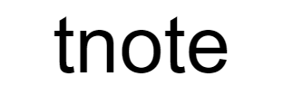

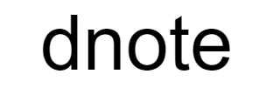

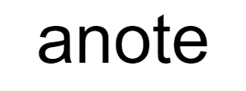



Frequency per string
Timing
Length
Mass per unit length
Duration
Decay time
Damping constant
Amplitude
Tension
Largest stable timestep
String index
Frequency

Slide 4



Slide 5


Slide 6

Numerical method is stable if and only if the distance traveled in one timestep moving at the wave speed is less than or equal to one spatial step.

Slide 7
Simulation Model
What am I doing here?

Slide 8





Temperature
Moisture
Pedal press

Slide 9

Temperature
Moisture
Pedal press

Slide 10

Temperature
Moisture
Pedal press

Slide 11
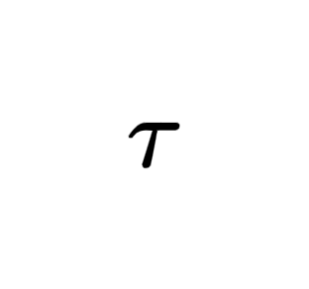

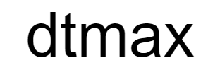


Slide 12





Slide 13
Implementation

Slide 14
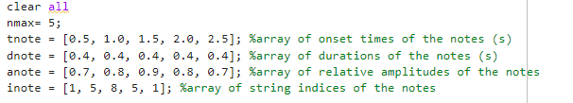
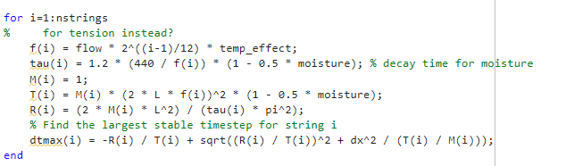

Slide 15
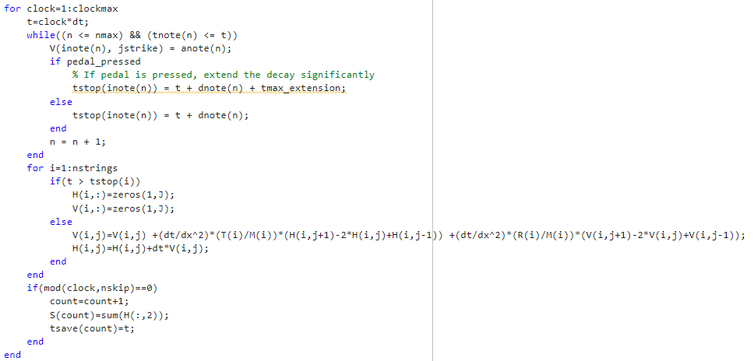

Slide 16
Results

Slide 17
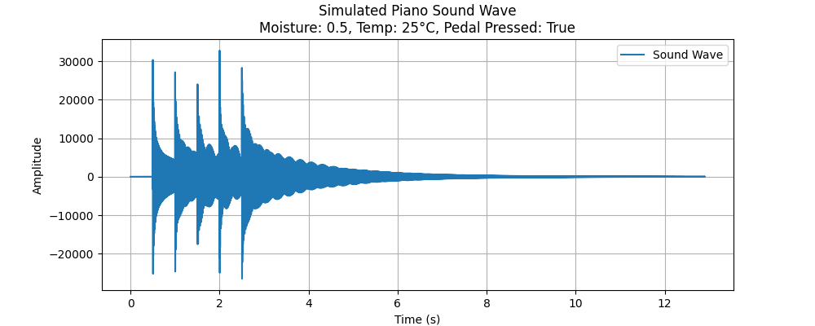


Slide 18
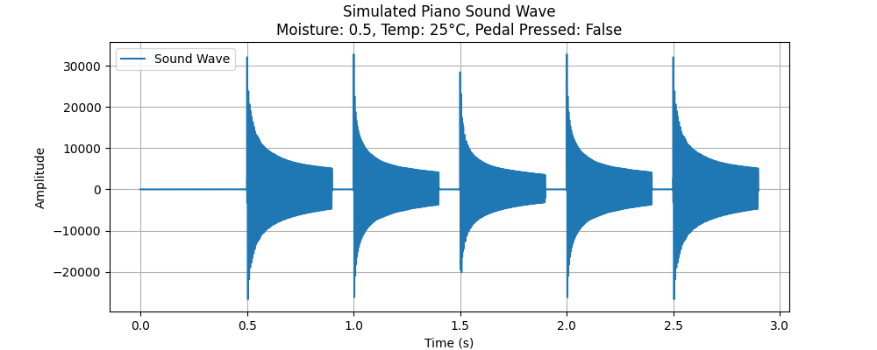

Slide 19
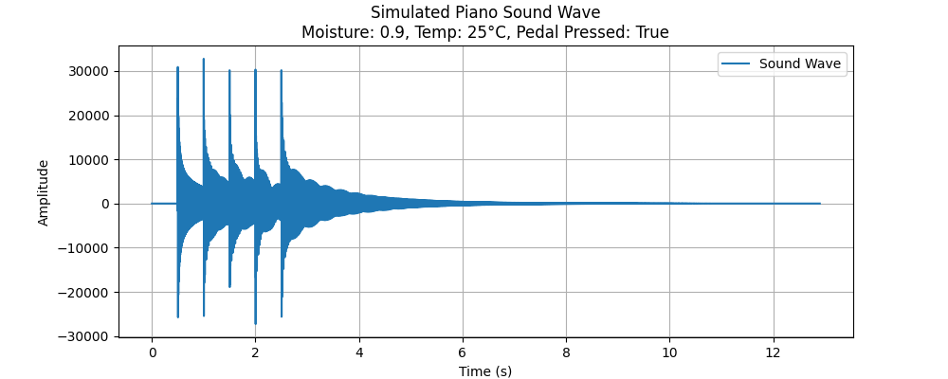

Slide 20


Slide 21
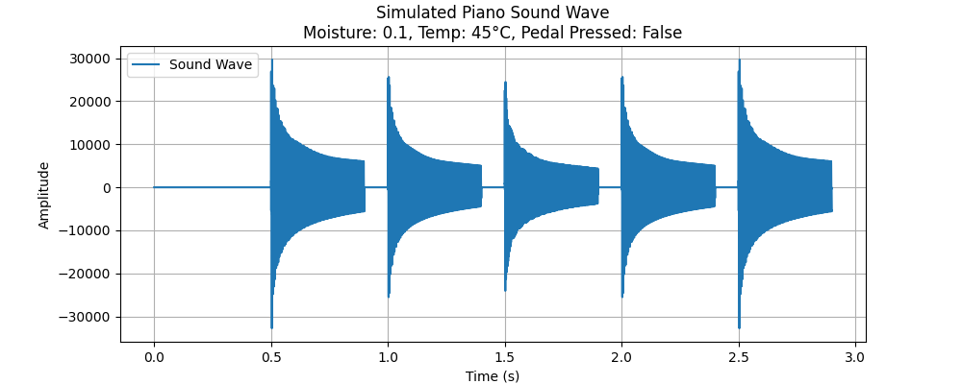

Slide 22
